Slide 1
THE VISIBILITY OF
“INVISIBLE DISABILITIES”
“INVISIBLE DISABILITIES”
Presented By : Rebecca Finch Vitsmun
American Humanist Association 83rd Annual Conference | 2024

Slide 2
WHAT ARE “INVISIBLE DISABILITIES”?
There is a movement to change “invisible disabilities” to hidden disabilities.
Hidden disabilities are conditions that limit certain activities,
or prevent equitable access, that are not immediately apparent.
American Humanist Association 83rd Annual Conference | 2024

Slide 3
TYPES OF HIDDEN DISABILITIES
Include, but not limited to:
hearing
mental health conditions
cognitive impairments
speech
neurodivergence
non-visible physical conditions
vision​
energy limiting conditions ​
American Humanist Association 83rd Annual Conference | 2024

Slide 4
MENTAL HEALTH CONDITIONS
22.8% of U.S. adults (NAMI 2023)
Sleep or appetite changes
Mood changes
Social Withdrawal
Drop in functioning
Problems thinking
Apathy
Feeling disconnected ​
Illogical thinking ​
Nervousness​
Unusual behavior​
Changes in school or work (APA 2022)
Creative Commons, Jose Luis Navarro Copyright: CC BY-NC-SA 4.0
American Humanist Association 83rd Annual Conference | 2024

Slide 5
COGNITIVE IMPAIRMENTS
13.9% of U.S. adults (CDC 2024)
More forgetful
Miss appointments/events
Lose track of thoughts/plotlines
Decision-making difficulty
Issues with task completion
Trouble following instructions​
Lost in familiar settings​
Develop poor judgement​
Noticeable in close relationships​
(Mayo Clinic 2024)
DE Toli, CC BY 4.0, via Wikimedia Commons
American Humanist Association 83rd Annual Conference | 2024

Slide 6
NEURODIVERGENCE
Sensory distinctions
Social differences
Intense emotional experiences
Intense focus or special interests
Executive functioning challenges
Varying aptitude in math or technology
Empathy and justice-oriented mindset
Artistic creativity
Language abilities
Thinking outside of the box
Memory variations
Need for movement breaks
Stimming
Unique gender and sexual orientation experiences
Pattern recognition and attention to detail
(Med Vidi 2023)
MissLunaRose12, CC BY-SA 4.0, via Wikimedia Commons
American Humanist Association 83rd Annual Conference | 2024

Slide 7
VISION
8% of U.S. (Health Policy Institute)
Ken Teegardin from Boulder, Boulder, CC BY-SA 2.0 <https://creativecommons.org/licenses/by-sa/2.0>, via Wikimedia Commons
No, CC BY-SA 4.0 <https://creativecommons.org/licenses/by-sa/4.0>, via Wikimedia Commons
With corrective lenses:
20/50 or less at distance/near
Visual field of 60 degrees or less
Progressive loss of vision
Medically documented condition
(Bradley Schools)
CC BY 4.0 <https://creativecommons.org/licenses/by/4.0>, via Wikimedia Commons
American Humanist Association 83rd Annual Conference | 2024

Slide 8
HEARING
15% of U.S. adults (NIDCD 2024)
Conductive (outer or middle ear)
Sensorineural (inner ear/nerve)
Mixed (conductive and sensorineural)
Auditory neuropathy spectrum
(sensorineural damage affecting sound organization)
https://openclipart.org/detail/313883/hearing
American Humanist Association 83rd Annual Conference | 2024

Slide 9
SPEECH
Fluency (flow) 7% U.S. children (NIDCD 2024)
Speech (clarity) 5% U.S. children (NIDCD 2024)
Voice 7.6% of U.S. adults (NIDCD 2024)
Orofacial Myofunctional 73.7% (ASHA)
(face/mouth/tongue muscles)
https://www.lookandlearn.com/history-images/YW011501V/A-doctor-examines-a-military-recruit-suffering-from-a-speech-disorder (cropped)
American Humanist Association 83rd Annual Conference | 2024

Slide 10
NON-VISIBLE PHYSICAL CONDITIONS
Affect all body systems. ​
Circulatory/cardiovascular
Digestive/excretory
Endocrine
Exocrine
Integumentary
Immune/lymphatic
Muscular
Nervous
Reproductive
Respiratory
Skeletal
Urinary/Renal
(Wikipedia 2024)
American Humanist Association 83rd Annual Conference | 2024
Notes:
asthma, cancer, heart conditions, connective tissue disorders, organs, skin if not visible,

Slide 11
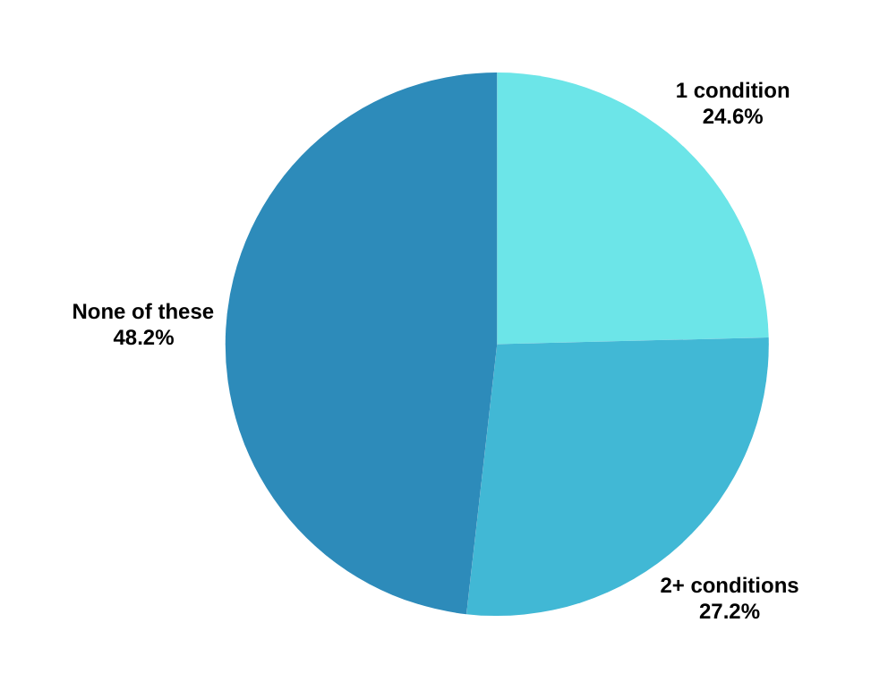
NON-VISIBLE PHYSICAL CONDITIONS
Prevalence of Chronic Conditions
Among US Adults (CDC 2020)
51.8%
arthritis, cancer, chronic obstructive pulmonary disease (COPD),
coronary heart disease, current asthma, diabetes, hepatitis, hypertension, stroke,
and weak or failing kidneys
48.2%
American Humanist Association 83rd Annual Conference | 2024
Notes:
asthma, cancer, heart conditions, connective tissue disorders, organs, skin if not visible,

Slide 12
ENERGY LIMITING CONDITIONS
~ 9% of U.S. adults
Breathing
​​Fatigue
Stamina
1 in 3 working-aged disabled adults
34% (DWP 2023)
2 in 5 disabled adults age 66+
43% (DWP 2023)
American Humanist Association 83rd Annual Conference | 2024

Slide 13
NON-EXHAUSTIVE LIST OF
HIDDEN DISABILITIES
ADHD
Anosmia
Anxiety disorders
Allergies
Arachnoiditis
Asthma
Autism Spectrum Disorder
Bipolar disorder
Brain injuries
Cancer
Charcot-Marie-Tooth disease
Chiari Malformation
Chronic fatigue syndrome
Chronic pain
Circadian rhythm sleep disorders
Coeliac Disease
Crohn's disease
Depression
Developmental Language disorder
Diabetes
Dysautonomia
Ehlers Danlos Syndrome
Endometriosis
Epilepsy
Fetal Alcohol Spectrum Disorder
Fibromyalgia
Food allergies
Fructose malabsorption
Hereditary Fructose Intolerance
Hyperhidrosis
Hypoglycemia
Inflammatory bowel disease
Intracranial Hypertension
Interstitial cystitis
Irritable Bowel Syndrome
Lactose Intolerance
Lupus
Lyme Disease
Lymphedema
Major depression
Metabolic syndrome
Migraine Misophonia Multiple Sclerosis
Multiple Chemical Sensitivity
Myasthenia Gravis
Narcolepsy
Personality disorders
Primary immunodeficiency
Psychiatric disabilities
Reflex Sympathetic Dystrophy
Repetitive stress injuries
Rheumatoid arthritis
Schnitzler's Syndrome
Schizophrenia
Scleroderma Sensory Processing Disorder
Sjögren's Syndrome
Small Fiber Sensory Neuropathy
Spinal Disorders
Temporomandibular joint disorder
Transverse Myelitis
Trigeminal Neuralgia
Ulcerative Colitis
(Disabled World)
American Humanist Association 83rd Annual Conference | 2024

Slide 14
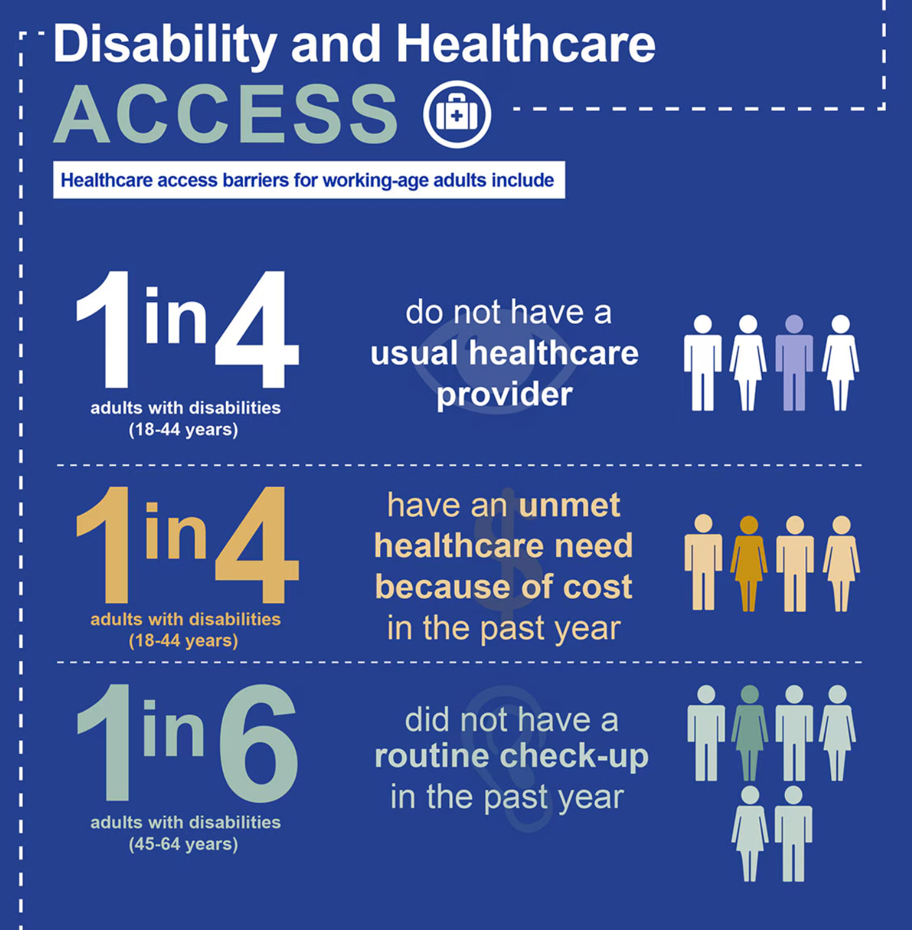
STATISTICS
75% are not disabled by their chronic conditions. (Disabled World 2023)
Approximately 10% of Americans have invisible disabilities. (Disabled World 2023)
It is estimated that 70-80% of disabilities are invisible. (UK Parliament 2023)
American Humanist Association 83rd Annual Conference | 2024
(Materials developed by CDC)

Slide 15
UNDERDIAGNOSIS
Diagnosis is a privilege.
Poverty
Environmental threats
Inadequate access
Individual Behavior
Educational Inequalities (CDC 2023)
Lack of Awareness
Emotional Cost​
Medical Bias​
Beliefs
Ivan Radic, CC BY 2.0 <https://creativecommons.org/licenses/by/2.0>, via Wikimedia Commons
American Humanist Association 83rd Annual Conference | 2024

Slide 16
WHAT CAN HUMANISTS DO?
Understand language cannot keep up with evolution.
Meet people where they're at.
American Humanist Association 83rd Annual Conference | 2024

Slide 17
INDIVIDUAL PARTICIPATION
Be visible. Be you. Tell your truth.
Accept. Believe. Accommodate.
Understand needs change.
Value give and take.
Interdependence, not codependence. Boundaries.
American Humanist Association 83rd Annual Conference | 2024

Slide 18
COMMUNITY CARE
Build communities as unique as the people in them.
Prioritize comfort, health, and safety.
Learn what people want/need from their community.
Learn what talents/strengths people want to contribute.
Develop surveys within your community.
Create opportunities that align with your people.
American Humanist Association 83rd Annual Conference | 2024

Slide 19
THE VISIBILITY OF THE “INVISIBLE”
Our differences can be seen in the way we live.
We may seem "weird."
We may know more/less about ourselves than typical.
We need accommodations.
Some of us wear Hidden disability's sunflower lanyards.
American Humanist Association 83rd Annual Conference | 2024

Slide 20
ABOUT ME
I enjoy writing artistic representations of hidden disabilities that
can be used to educate people on how to see the "invisible".
Rebecca Finch Vitsmun
Website: rebeccavitsmun.com
Email: rebeccavitsmun@gmail
Facebook: /RebeccaVitsmun
Instagram: /@rvitsmun
TikTok: /@rebeccavitsmun
YouTube: /@rebeccavitsmun
American Humanist Association 83rd Annual Conference | 2024

Slide 21
RESOURCES
American Speech-Language-Hearing Association. (n.d.). Orofacial Myofunctional Disorders. (Practice Portal). Retrieved September 10, 2024, from www.asha.org/Practice-Portal/Clinical-Topics/Orofacial-Myofunctional-Disorders/ Boersma P., Black L.I., Ward B.W.. (2020) Prevalence of Multiple Chronic Conditions Among US Adults, 2018. Prev Chronic Dis 2020;17:200130. DOI: http://dx.doi.org/10.5888/pcd17.200130 Invisible disabilities: List and general information | disabled world. (2023, May 1). Disabled World. https://www.disabled-world.com/disability/types/invisible/
Disability impacts all of us infographic | cdc. (2024, July 3). U.S. Centers for Disease Control and Prevention. https://www.cdc.gov/ncbddd/disabilityandhealth/infographic-disability-impacts-all.html
Community care. (n.d.). Mental Health America. Retrieved September 9, 2024, from https://www.mhanational.org/bipoc-mental-health/community-care
Family Resources Survey: Financial year 2021 to 2022. (2023, July 21). GOV.UK. Department for Work & Pensions. Retrieved September 8, 2024, from https://www.gov.uk/government/statistics/family-resources-survey-financial-year-2021-to-2022/family-resources-survey-financial-year-2021-to-2022
Health disparities | cdc. (2023, May 26). U.S. Centers for Disease Control and Prevention. Retrieved September 9, 2024, from https://www.cdc.gov/healthyyouth/disparities/index.htm
Khaliq, R. (2023, August 18). Neurodiversity: A guide to its types and neurodivergent conditions examples. MEDvidi. https://medvidi.com/blog/types-of-neurodiversity
List of systems of the human body. (2024). Wikipedia. https://en.wikipedia.org/w/index.php?title=List_of_systems_of_the_human_body
Mental health by the numbers. (2023, April). National Alliance of Mental Illness. Retrieved September 8, 2024, from https://www.nami.org/about-mental-illness/mental-health-by-the-numbers/
Mild cognitive impairment—Symptoms and causes. (2024, February 13). Mayo Clinic. Retrieved September 9, 2024, from https://www.mayoclinic.org/diseases-conditions/mild-cognitive-impairment/symptoms-causes/syc-20354578 Ng, Anthony T. M.D., DFAPA. Warning signs of mental illness. (2022). American Psychiatric Association. Retrieved September 9, 2024, from https://www.psychiatry.org:443/patients-families/warning-signs-of-mental-illness
Quick statistics about voice, speech, language | nidcd. (2024, March 4). National Institute of Deafness and Other Communication Disorders https://www.nidcd.nih.gov/health/statistics/quick-statistics-voice-speech-language Quick statistics about hearing, balance, & dizziness | nidcd. (2024, March 4). National Institute of Deafness and Other Communication Disorders. https://www.nidcd.nih.gov/health/statistics/quick-statistics-hearing
Visual impairments. (n.d.). Health Policy Institute. Georgetown University. Retrieved September 9, 2024, from https://hpi.georgetown.edu/visual/
What is a speech impairment? (2024, August 15). Cleveland Clinic. Retrieved September 10, 2024, from https://my.clevelandclinic.org/health/diseases/speech-impairment

